Slide 1

Project NHL
By Steven Ginzberg

Slide 2
Scraping NHL.com
Scraped from 2012-13 through 2015-16
Gap in games during 2012-13 for the NHL lockout
Received all events for 4,308 out of a possible 9600 games
Event types include Goals, Penalties, Face-offs, Shots, Blocks, etc.
1.765 million records and 56 fields
Some data is missing relating to game header information
Approx. 170,000 records, or 10%

Slide 3
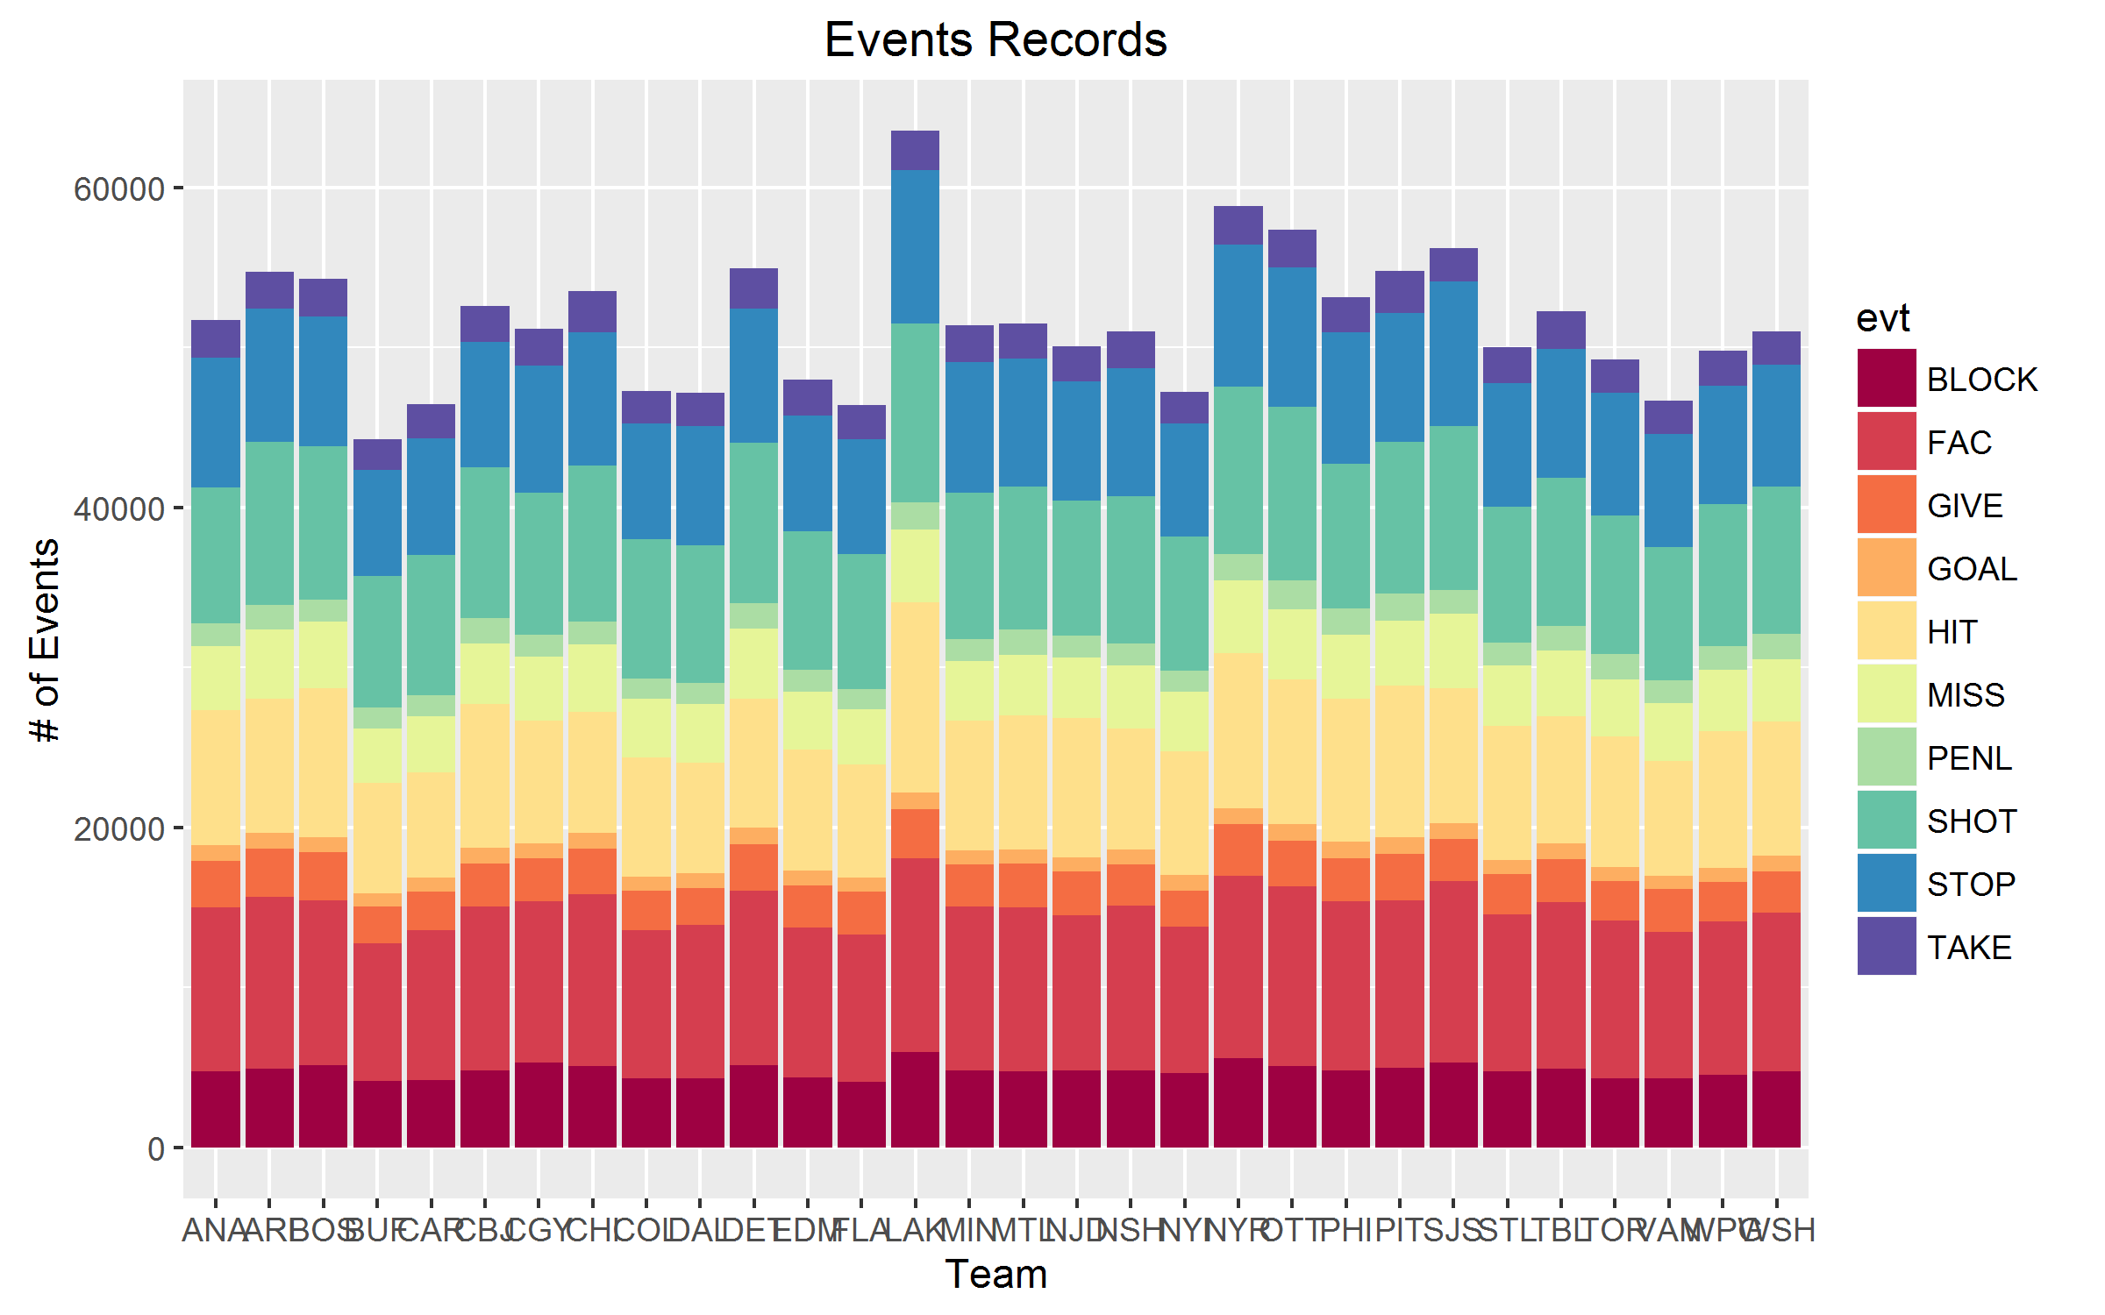
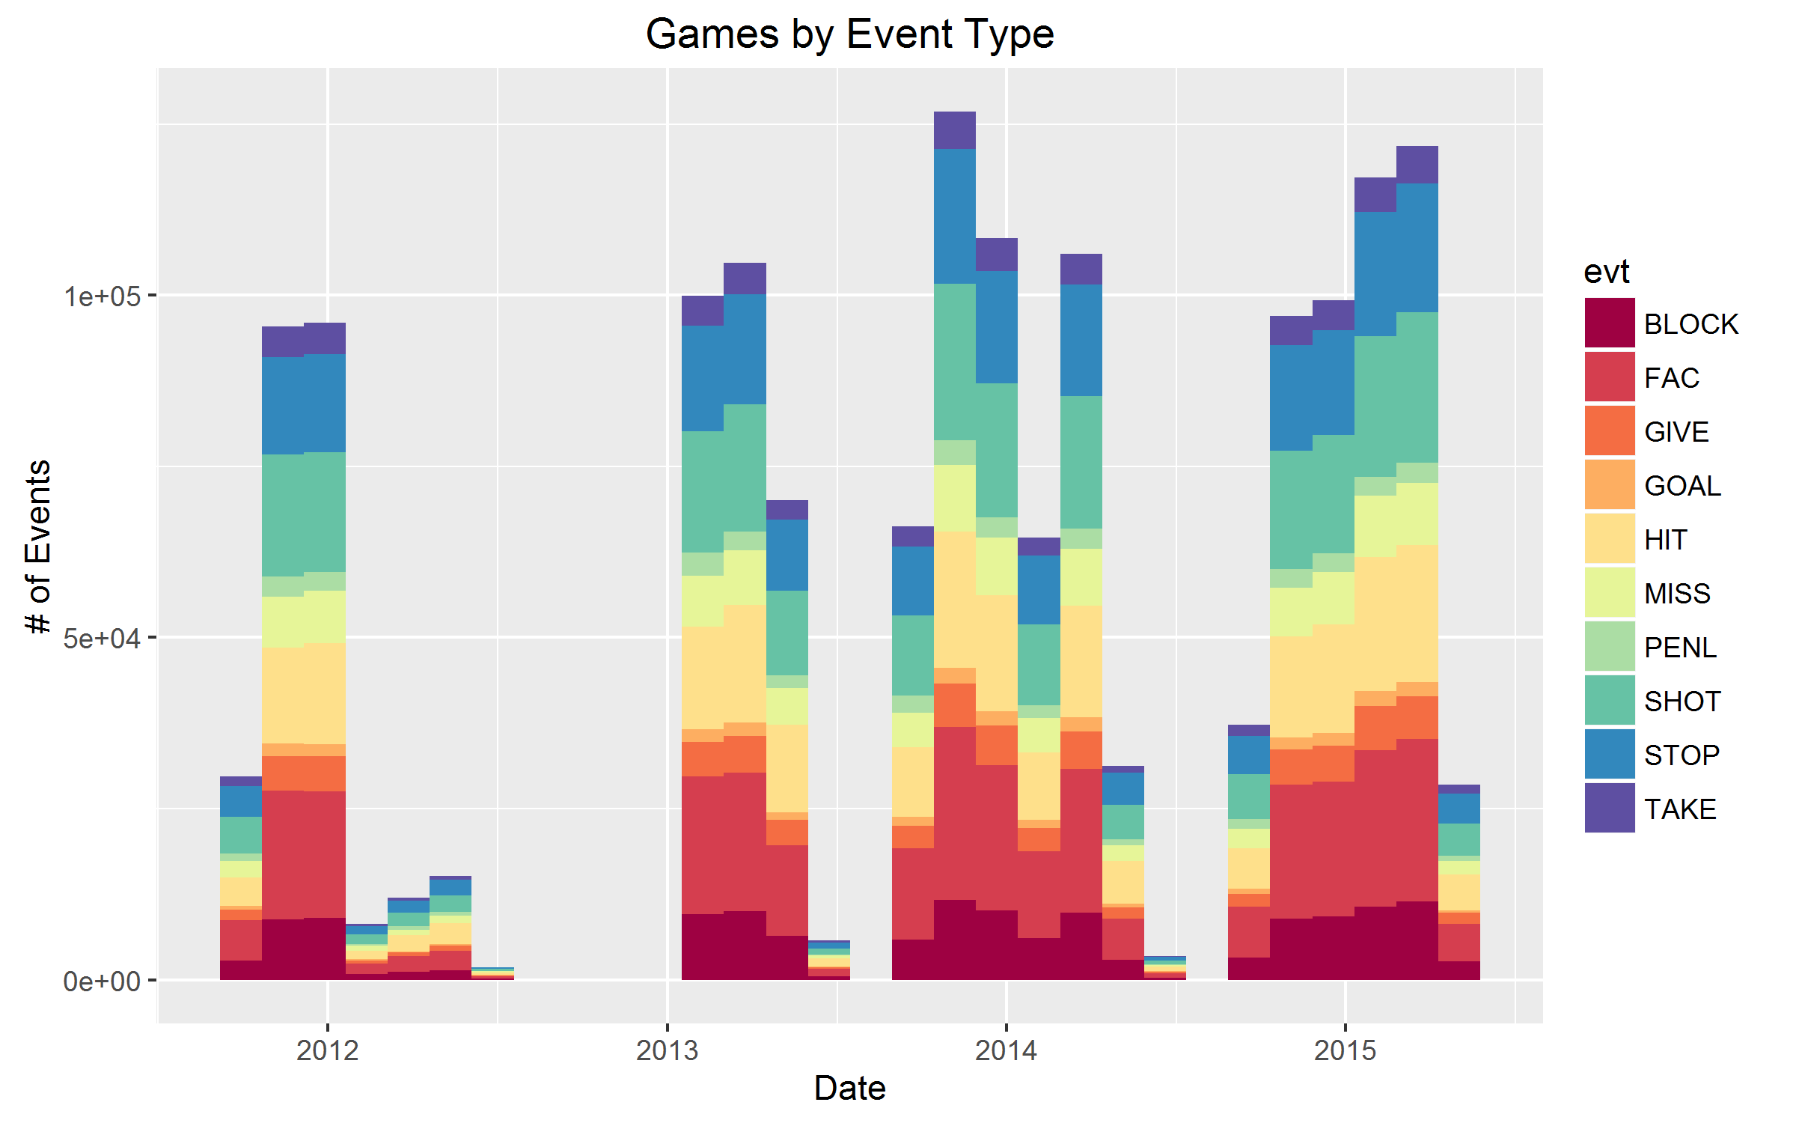
Database Visually

Slide 4
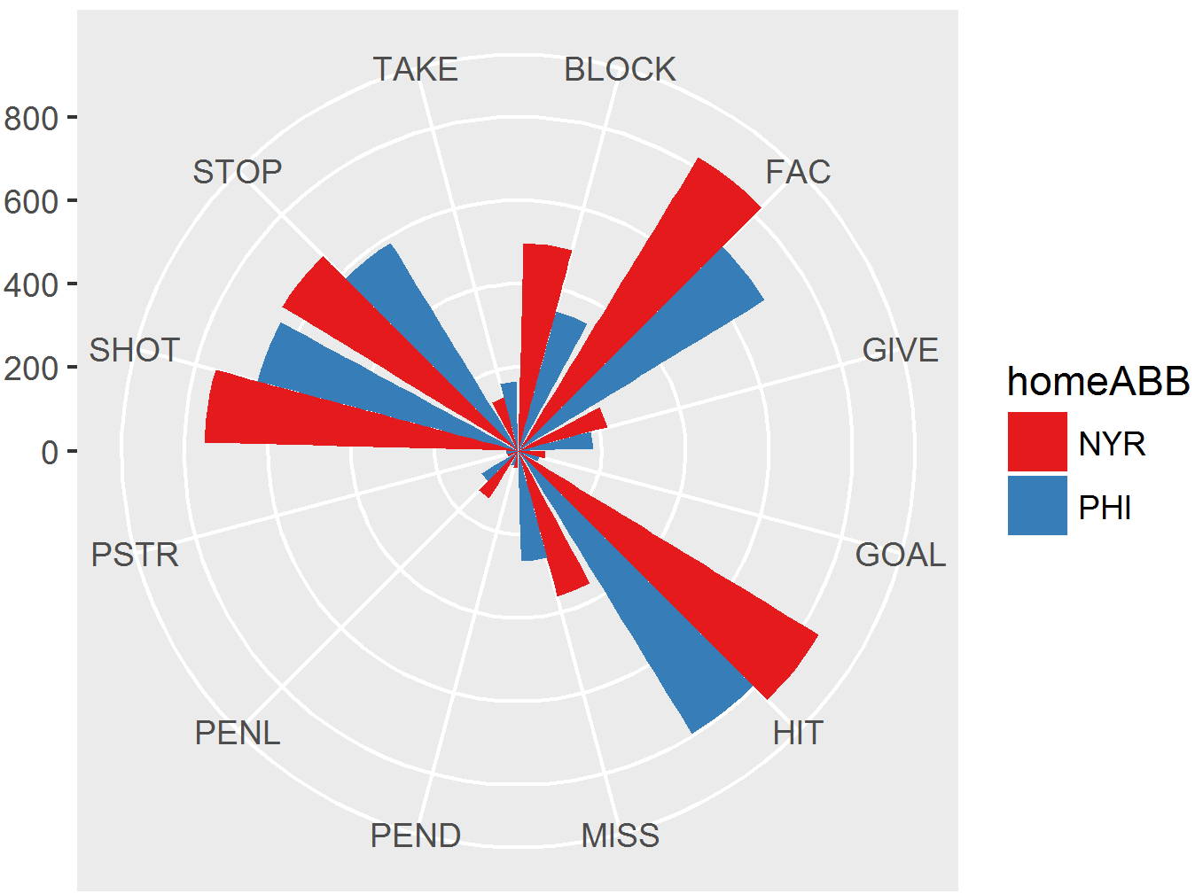
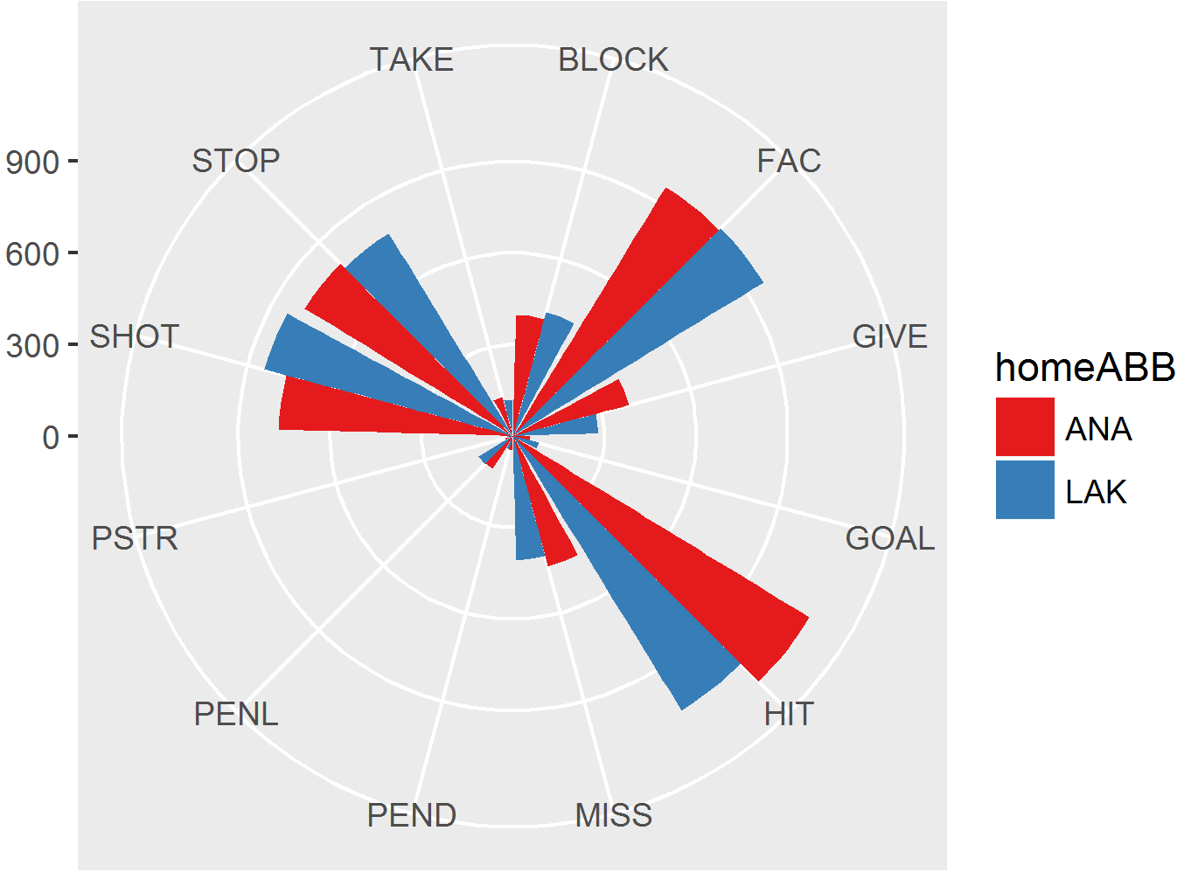
Database Visually

Slide 5
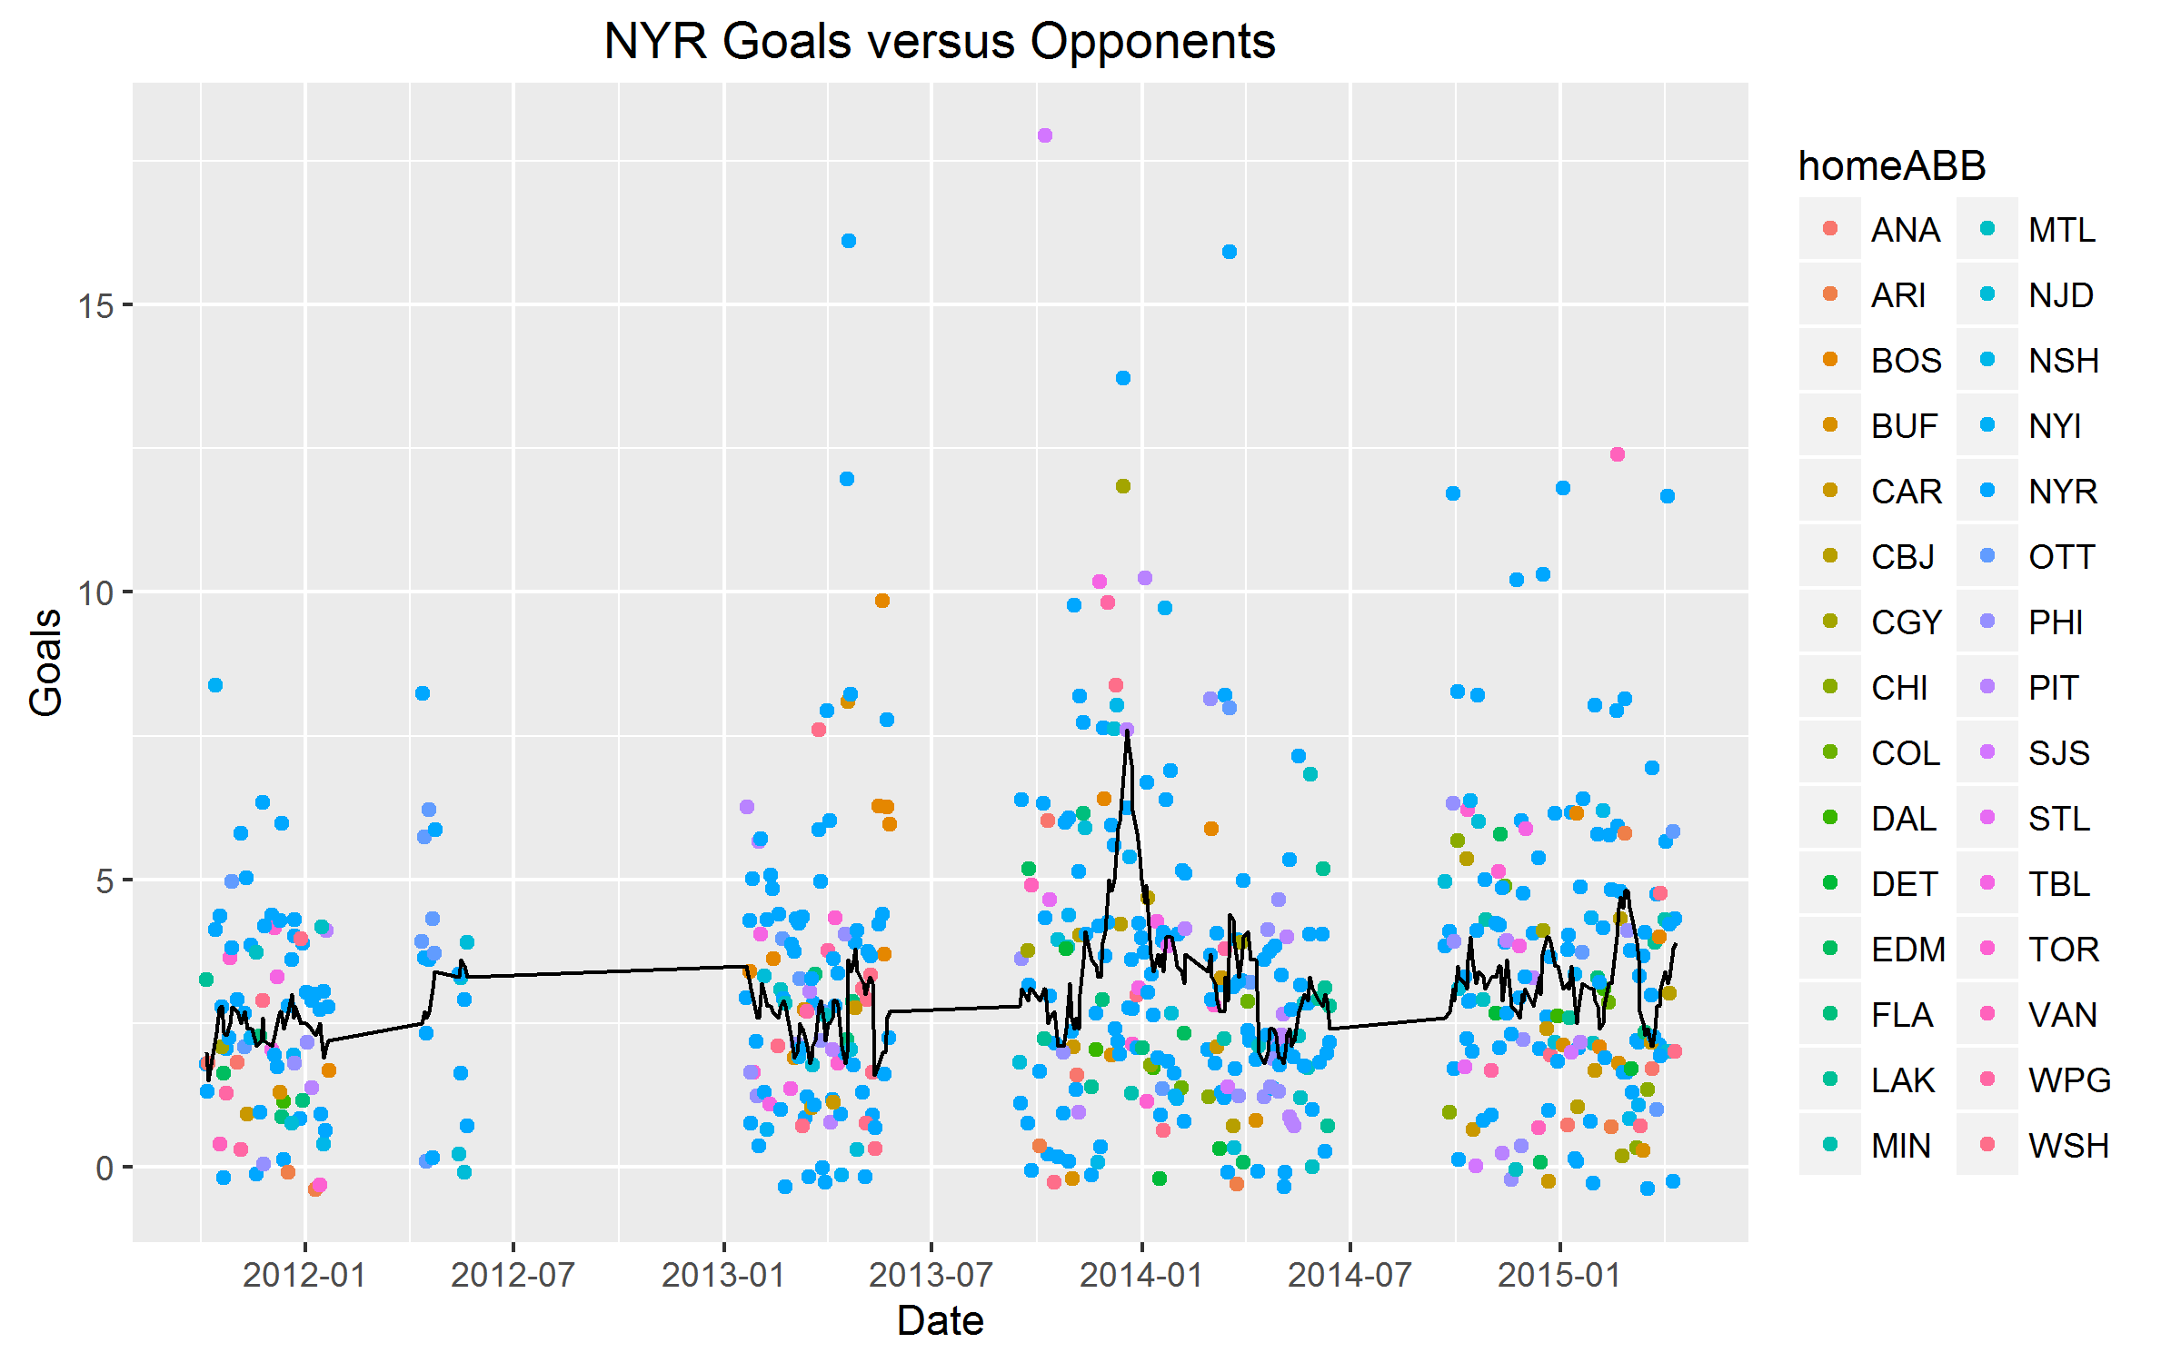
Visualizing Moving Averages

Slide 6
Machine Learning Algorithms
The objective is to learn from a series of events and try to predict the likelihood of a goal.
Using event database required setting up a separate column for goal and removing the goal events.
In the best case, I was expecting change in odds to be minimal
Naïve-Bayes Model:
Uses all available evidence
Works well with categorical and text-based data
Result was it predicted NO GOALS
the likelihood of a goal in any case is very small so it always went to zero.
Logistic Model:
Attempts to get probabilities failed – needed a huge amount of memory

Slide 7
Going Forward
Fix current issues:
I need to scrape for the missing data and set up an application to scrape during the season
Switch to an Linear or Logistic model that can handle both categorical and continuous variables and provide odds of success
Future issues:
Break down text fields to include player by player data – great for fantasy sports!
Additional visuals during the course of the season

